Slide 1

Module 1: Calculus
Department of Mathematics Jain Global campus, Jakkasandra Post, Kanakapura Taluk, Ramanagara District -562112
Prof. Veeresh Malagi
Department of Mathematics,
FET, Jain(Deemed-to-be-University)

Slide 2
Contents
Rolle’s Theorem
Mean Value Theorems (Lagrange's Mean Value theorem & Cauchy's Mean value theorem)
Taylor’s and MacLaurin’s series for Exponential, Trigonometric and Logarithm functions
Indeterminate forms and L'Hospital's rule.

Slide 3
Rolle’s Theorem

Slide 4
Rolle’s Theorem and its Geometrical Interpretation

Slide 5
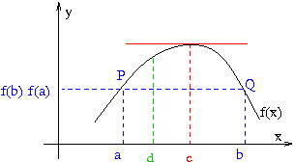
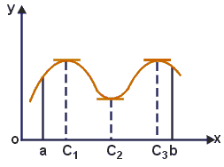
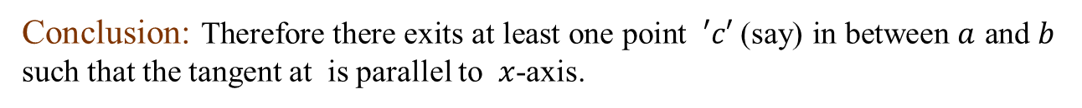
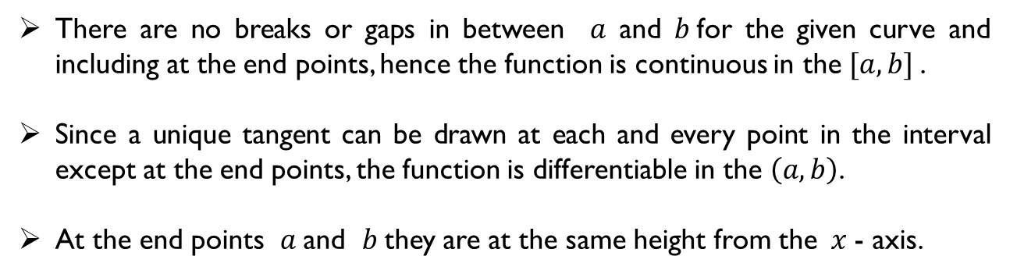
Geometrical Interpretation
There are no breaks or gaps in between $a$and $b$for the given curve and including at the end points, hence the function is continuous in the $[a, b]$.
Since a unique tangent can be drawn at each and every point in the interval except at the end points, the function is differentiable in the $\left(a, b\right)$.
At the end points $a$and $b$they are at the same height from the $x$- axis.
Conclusion: Therefore there exits at least one point $′c′$(say) in between $a$ and $b$ such that the tangent at is parallel to $x$-axis.

Slide 6

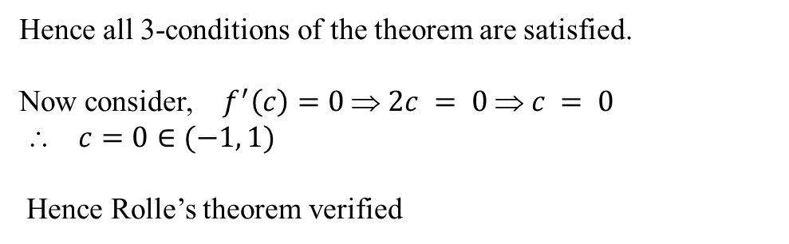




Problems on Rolle's Theorem
1) Verify Rolle’s theorem for the function $f(x)=x^{2}$in [-1, 1]
Solution:
$f(x)=x^{2}$ is continuous in [-1, 1]
$$⇒$$
$f^{′}\left(x\right)=2x$is exist for all values in [-1, 1]
$$⇒$$
∴$f\left(−1\right)=f(1)$=1
Hence all 3-conditions of the theorem are satisfied.
Now consider, $f^{′}\left(c\right)=0 ⇒ 2c = 0 ⇒ c = 0$
$ c=0∈(−1, 1)$
Hence Rolle’s theorem verified

Slide 7


Verify Rolle’s theorem for the function in $f\left(x\right)=x^{3}−{3x}^{2}−x+3x$ in [1, 3]
Solution:
$$⇒$$
$$⇒$$

Slide 8
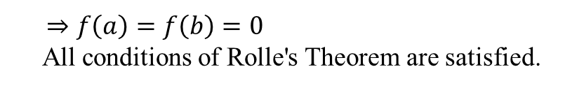
3) Verify Rolle's Theorem for the function
Solution:
$⇒f\left(a\right)=f\left(b\right)=0$
All conditions of Rolle's Theorem are satisfied.

Slide 9


4) Verify the Rolle’s theorem for the function in [$a, b$]
Solution:
$$⇒$$
$$⇒$$

Slide 10


5) Verify Rolle’s theorem for the function in
Solution:
$$⇒$$
$$⇒$$

Slide 11


6)
Solution:
$$⇒$$
$$⇒$$

Slide 12

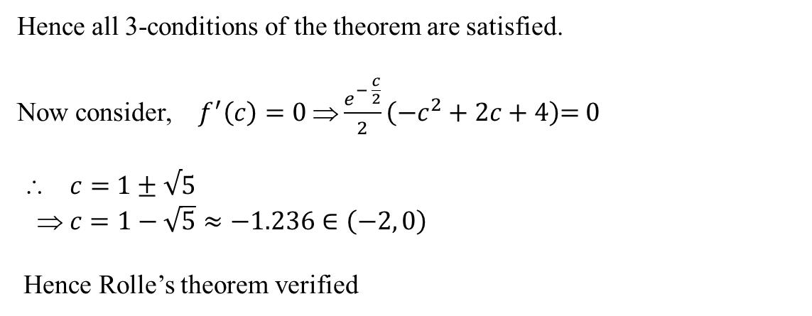

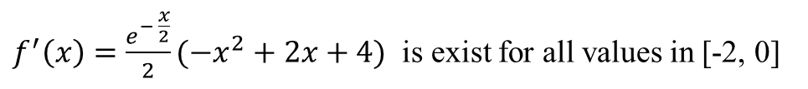
7) Verify Rolle’s theorem for the function $f(x)={x\left(x+2\right)e}^{−x/2}$in [-2, 0]
Solution:
$f(x)={x\left(x+2\right)e}^{−x/2}$is continuous in [-2, 0]
$$⇒$$
$f^{′}\left(x\right)=$$\frac{e^{− \frac{x}{2}}}{2}({−x}^{2}+2x+4)$ is exist for all values in [-2, 0]
$$⇒$$
∴$f\left(−2\right)=f(0)$= 0
Hence all 3-conditions of the theorem are satisfied.
Now consider, $f^{′}\left(c\right)=0 ⇒\frac{e^{− \frac{c}{2}}}{2}\left({−c}^{2}+2c+4\right)$= 0
$ c=$$1±√5$
$ c=1−\sqrt{5}≈−1.236$$∈\left(−2, 0\right)$
Hence Rolle’s theorem verified

Slide 13

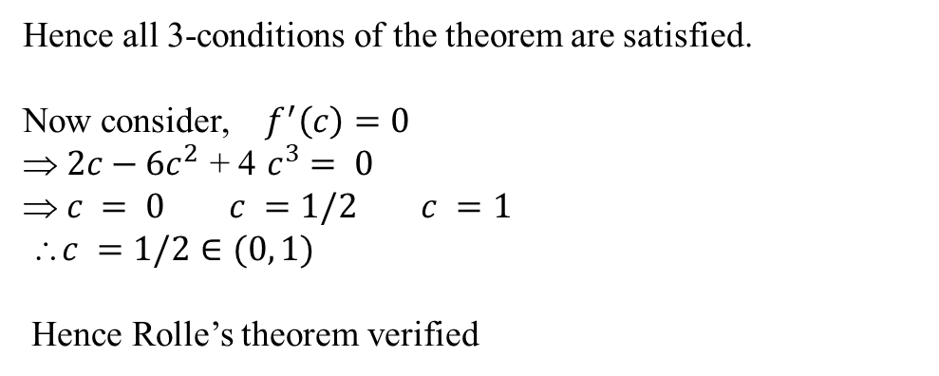


8) Verify Rolle’s theorem for the function $f(x)=x^{2}{(1−x)}^{2}$ in [0, 1]
Solution:
$f(x)=x^{2}{(1−x)}^{2}$is continuous in [0, 1]
$$⇒$$
$f^{′}\left(x\right)=2x−6x^{2}$ + 4$x^{3}$is exist for all values in [0, 1]
$$⇒$$
∴$f\left(0\right)=f(1)$ = 0
Hence all 3-conditions of the theorem are satisfied.
Now consider, $f^{′}\left(c\right)=0$
$ 2c−6c^{2}\text{ + 4} c^{3}= 0$
$ c = 0 c =1/2$$c =1$
$c =1/2∈(0, 1)$
Hence Rolle’s theorem verified

